Slide 1
Book Management Web Application

Slide 2
Presented to you by:
ISHAN (1510991273)
RAHUL PASSI(1510991496)
RAVJOT SINGH(1510991513)
RITESH KAMRA(1510991529)

Slide 3
Introduction
The Modern-Day lives we live today are fast paced and hence the facilities provided by the Libraries which were once sufficient are now barely adequate.
These facilities lack the changes which need to be done in order to attract the new generation of who people who value their time and hobbies.

Slide 4
Hence, this project provides the new generation and the old to step into the next phase of reading online with certain additions of our own.
These changes would ensure that satisfaction is achieved by those who access and uses our website.

Slide 5
Features
Access to E-Books in a variety of Genres.
Gmail login system for security.
Promoting free and fair access of books to the public.

Slide 6
Technologies used
Flask :- A web micro framework of python. It is classified as a micro framework because it does not require particular tools or libraries and it is licensed under a BSD License.
SQLite :- An embedded RDBMS.
Gmail API :- Used for login purposes.

Slide 7
Functioning
The web application will present a simple login system via Gmail-id which will give access to the user to add books of their own.
It is not necessary to login in order to read the books, only to add or edit details.

Slide 8
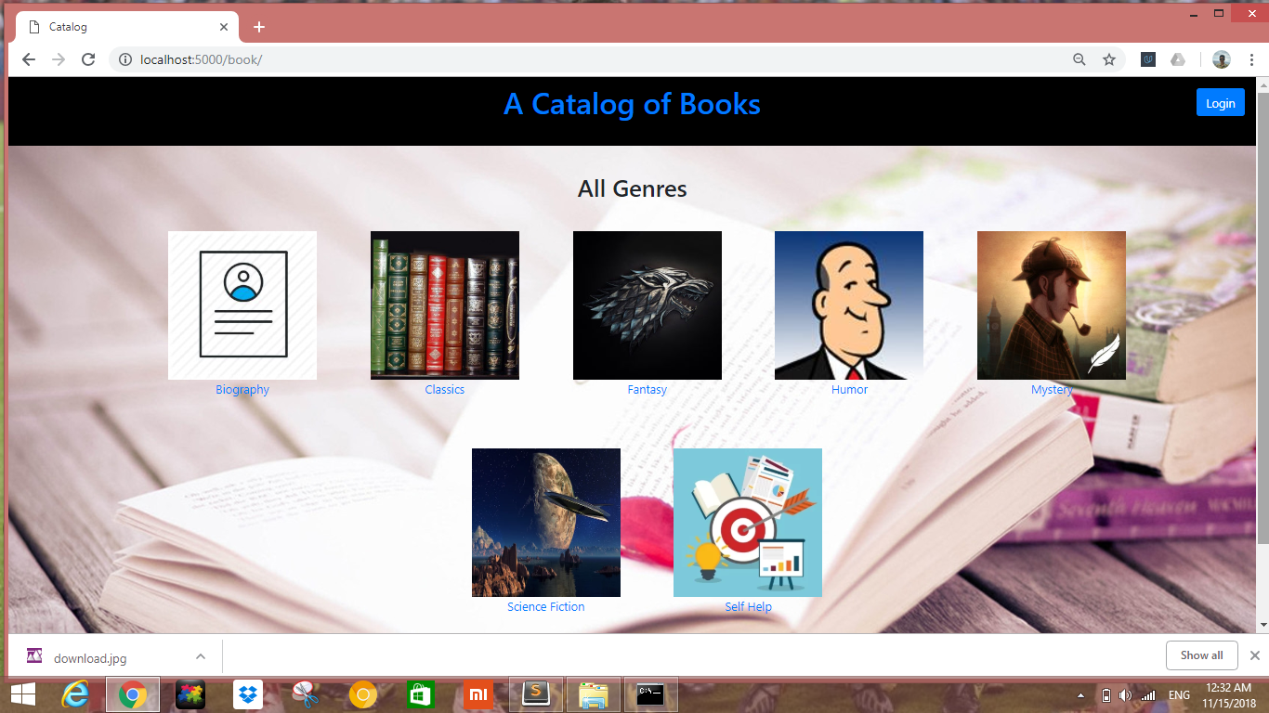
Demo (Home page)

Slide 9
There are options of various genres to choose from and the content which is added by one person cannot be altered or removed by another ensuring security of the content.
This is done to reduce the toxic part of the internet community.

Slide 10
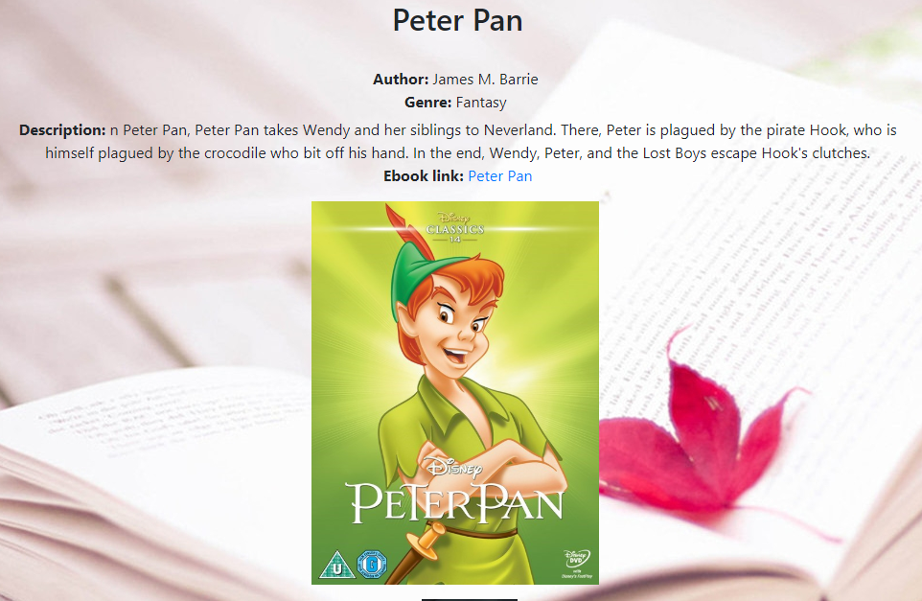
Example of Book

Slide 11
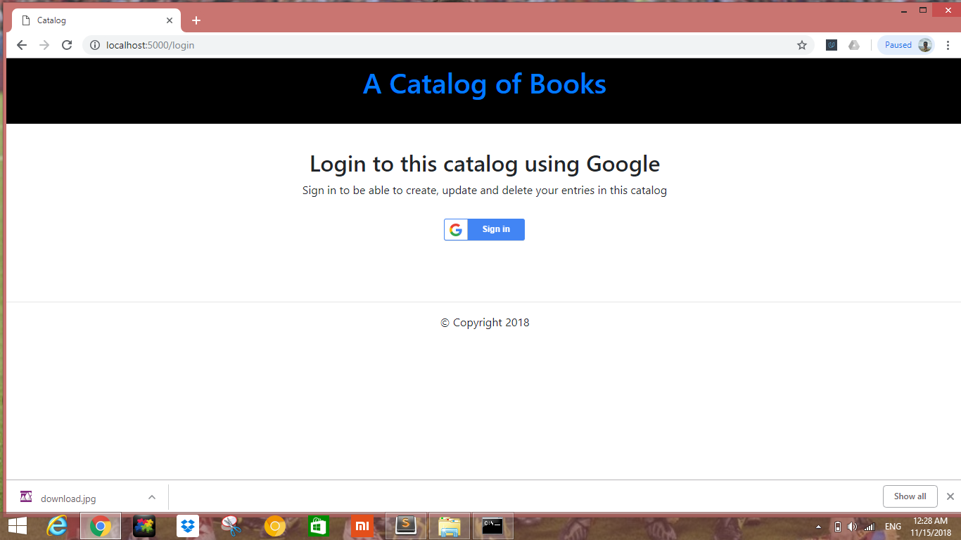
Gmail Login

Slide 12
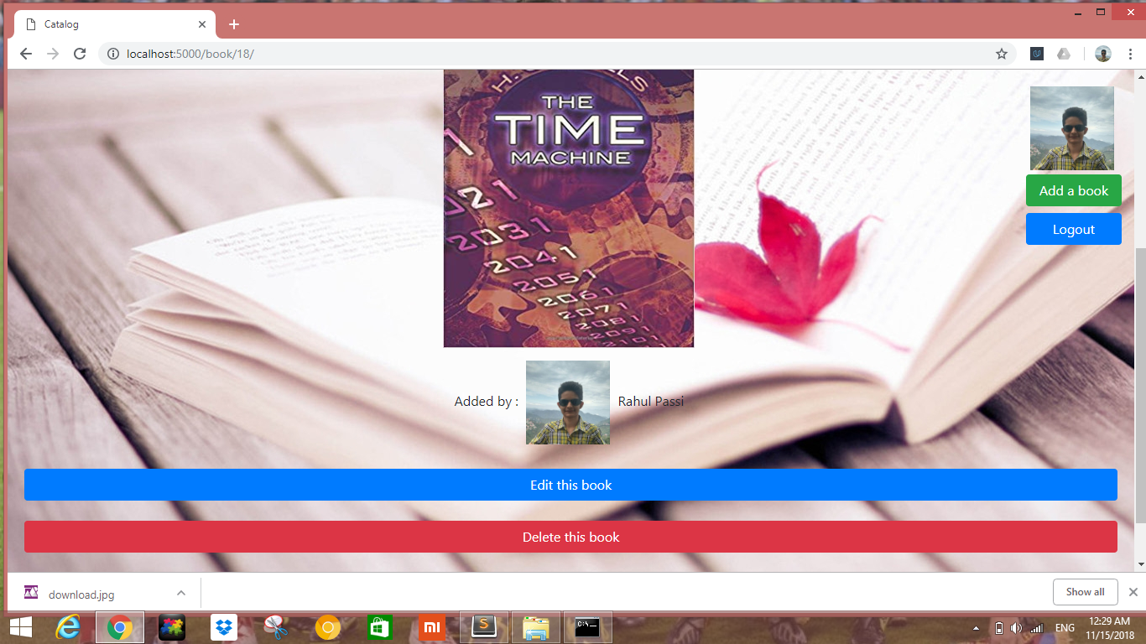
Addition of New Content

Slide 13
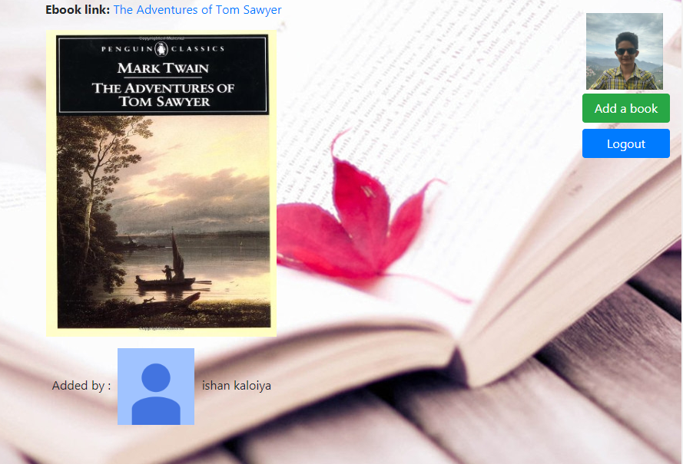
Viewing Other’s Content

Slide 14
THANK YOU

